Slide 1
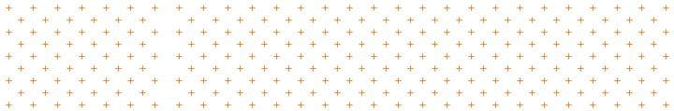
Fundamentals of Human-Centered Design
Day 1
Peter Gorman | peter.gorman@opm.gov
Mina Jafarpoor | mina.jafarpoor@opm.gov
Judy Conley | judy.conley@navy.mil
Nick Jones | nicholas.j.jones1@navy.mil
Notes:
PG

Slide 2

Introduce:
The Lab + Each Other
Notes:
PG

Slide 3

The Lab at The Office of Personnel Management
Welcome + Introductions
The Lab at OPM (The Lab) fosters innovation through design. We teach human-centered design across the Federal Government and help deliver innovative solutions to address complex public and cross-sector challenges.
TEACHING | DOING | LEADING
https://lab.opm.gov
Notes:
PG

Slide 4
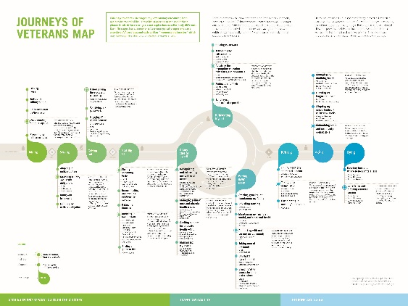
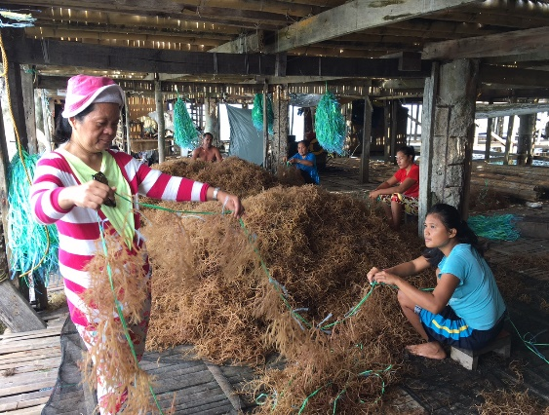

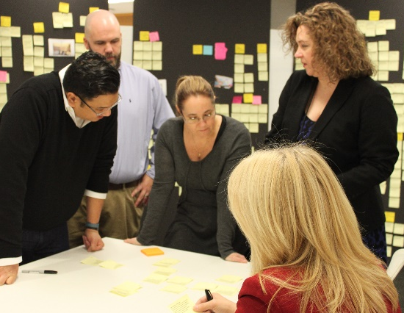

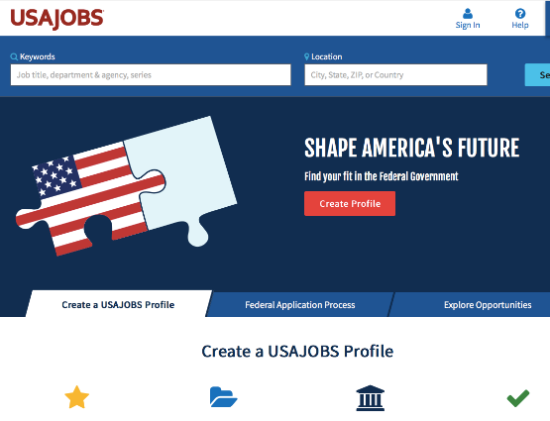
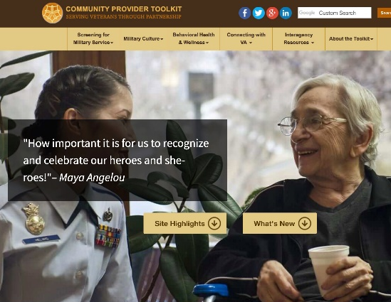
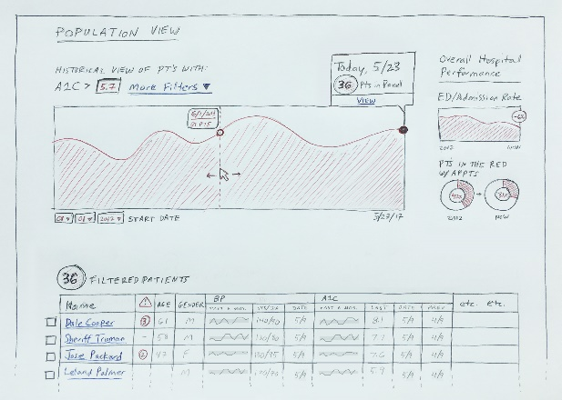
The Lab’s Portfolio
Welcome + Introductions
Our work ranges from pure stakeholder-insight and discovery efforts to full design and piloting projects.
We’ve done experience mapping with VA, form design with USDA, full-stack development for USA Jobs, etc...
Notes:
PG
Veterans’s journey Millenium Challenge Corporation – ethnographic research on seaweed farmers
FDA’s Center for Devices and Radiological Health --- how to align testing standards for a product’s testing standards are regulated by 2 different agencies (FDA and NIOSH)
USA JOBS – looking at how to design the experience of hiring and seeking employment in the federal government.
VA Community Provider Toolkit – evolving an existing product with awareness of its actual – not presumed- stakeholders Seeks to covey knowledge re: providing mental health care to veterans to non-VA providers of those services.
Work with FDA Food and Nutrition Service’s Free and Reduced School Meals program aimed at simplifying and improving the application experience for families applying for that support.

Slide 5
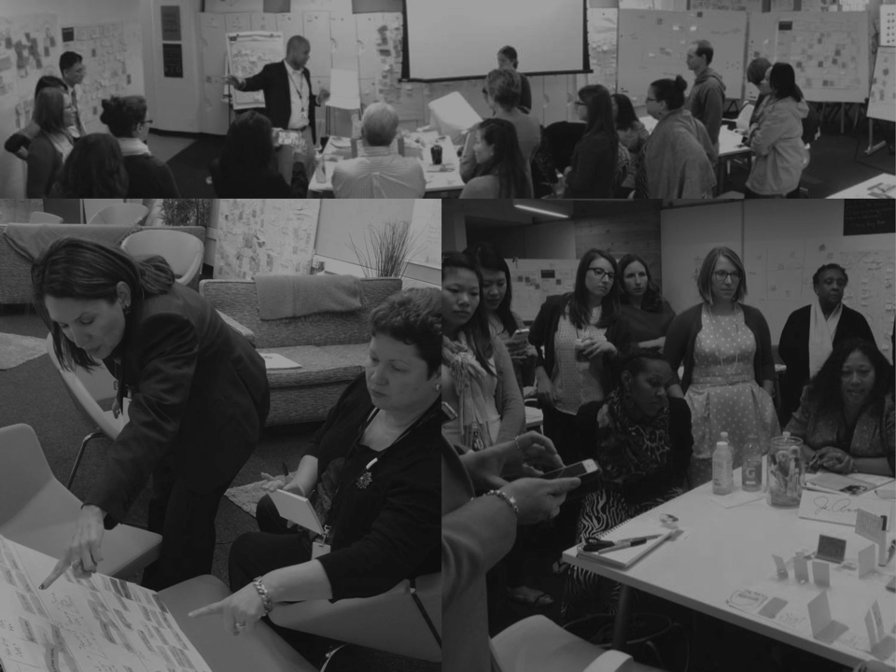
Let’s introduce ourselves...
Please tell us:
Your name
Organization & title
Interest in and/or experience with human-centered design
Notes:
PG

Slide 6
Align:
Objectives + Expectations
Notes:
MJ

Slide 7
Over the next 3 days we will…
Objectives + Expectations
Develop an understanding of the mindsets, methods, and tools in the discipline of human-centered design (HCD).
Explore how to apply HCD to the challenges you may find at work.
Improve collaboration and co-creation skills.
Learn to design within constraints and to accept constraints as a key part of the design process.
Notes:
MJ

Slide 8
The Guiding Principles and Spirit of Our Course
Objectives + Expectations
This workshop is just an introduction to HCD; being proficient will take longer than three days.
You need to fully participate and minimize work or personal distractions.
We believe that collaboration is a survival strategy, not just a choice; this workshop hinges on your ability to collaborate with others.
Suspend what you know and what you are comfortable with. Take some risks. Nobody will judge you for it.
Notes:
MJ
An access check-in allows people to share any access needs they might have, if they feel comfortable.
For example, “I may need to step out of the room from time to time” or “I will often go to the back of the room to do stretches as I listen” or “I need people to speak up when they speak.”
This is a useful way to value access and destigmatize it in an ableist culture that hides, shames and individualizes access. This is also a useful way to remind people that everyone has access needs, not only people with disabilities. It is important to note that many people will not share their access needs and that is okay. This is especially true if people do not have anyone in the room with whom they have access intimacy. We don’t want to replicate a culture of ableism and forced intimacy that disabled people have to endure every day. Never force anyone to share their access needs.

Slide 9
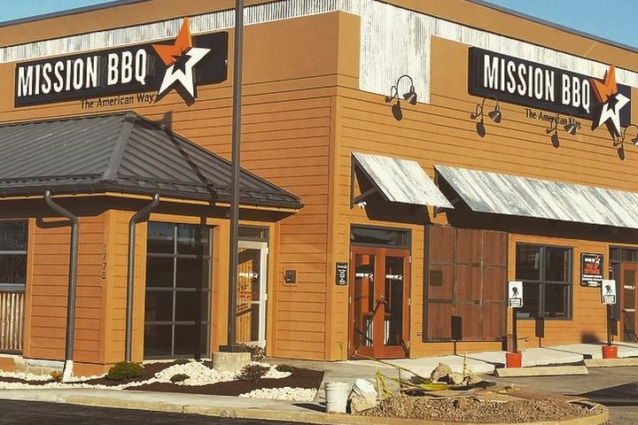
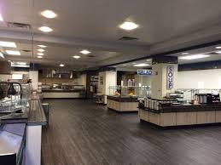
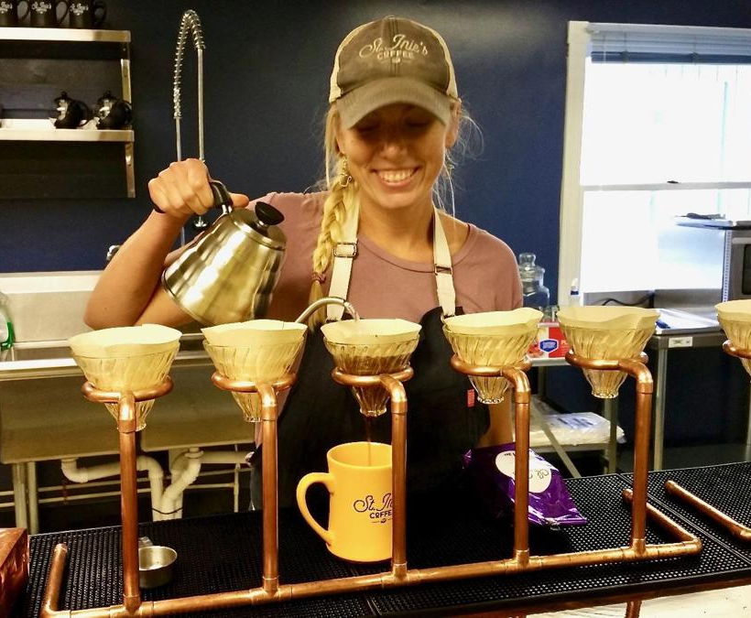
Our Design Challenge*
*a task or situation that tests someone’s abilities
Objectives + Expectations
Your challenge for these three days will be:
To improve the experience of “having lunch” for the local workforce of California, MD or Pax River
Notes:
MJ

Slide 10
Day 1 Agenda
Objectives + Expectations
Introduce: The Lab + Each Other
Align: Objectives + Expectations
Explain: Human-Centered Design
Break
FRAME: Problem Framing
Break
EXPLORE: Design Ethnography
EXPLORE: Fieldwork Preparation
Lunch + Fieldwork 11:30–2:30pm
Reflect: Fieldwork Debrief
Wrap Up 3:00pm
Notes:
MJ

Slide 11
Explain:
Human-Centered Design
Notes:
MJ

Slide 12
Innovation and Design
Human-Centered Design
Take a moment to reflect on what these terms meant to you. Write down some keywords, thoughts, etc.. Share them with the group.
Notes:
MJ

Slide 13
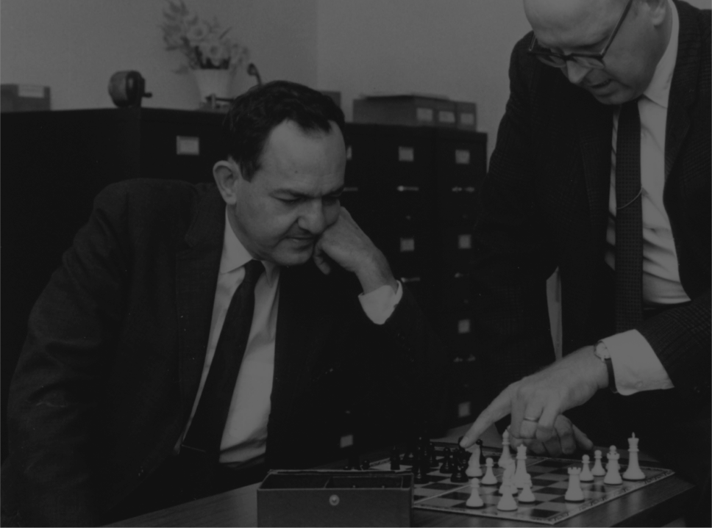
Everyone designs who devises courses of action aimed at changing existing situations into preferred ones.
“
–
Herbert Simon
Economist, psychologist, and design theorist
Human-Centered Design
Notes:
MJ

Slide 14
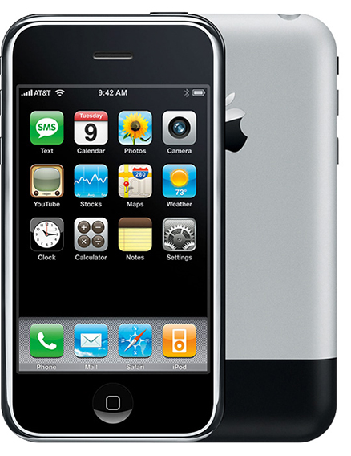
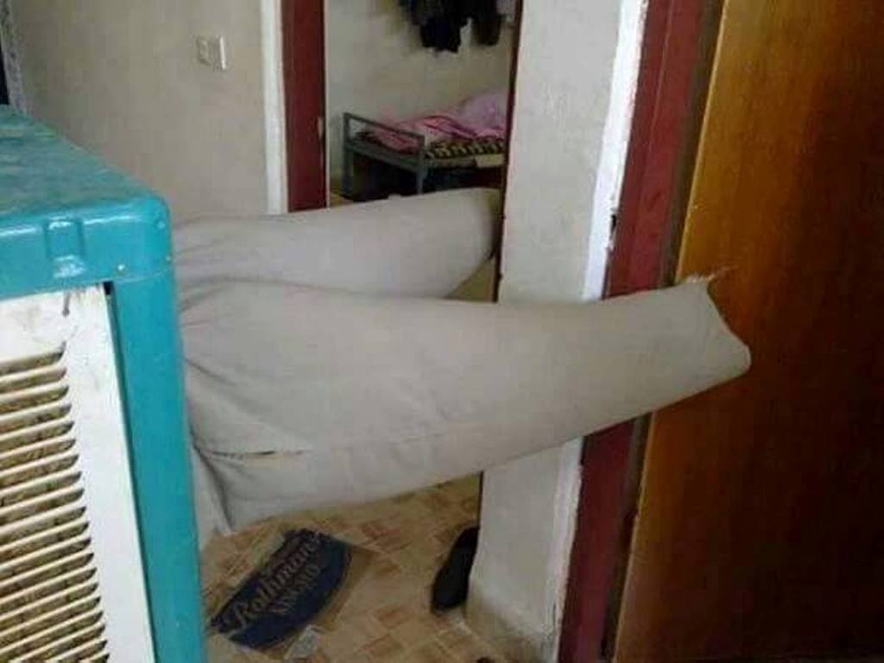
Breakthrough Products
Human-Centered Design
Notes:
MJ
Original iPhone 2007 / vs / air conditioner + pants (Hindi: “Jugaad”)

Slide 15
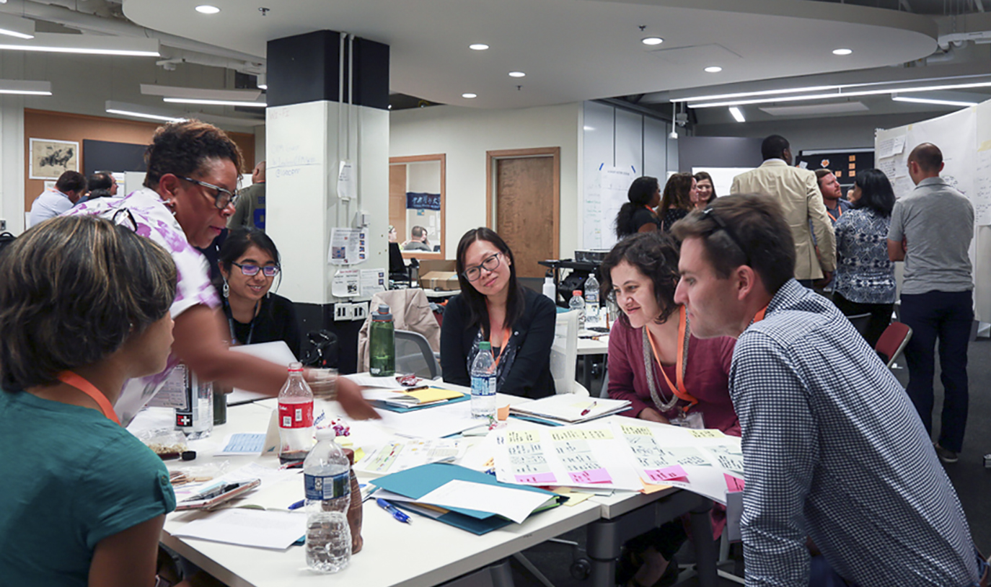
Breakthrough Processes
Human-Centered Design
Notes:
MJ

Slide 16
So then, what’s human-centered design?
Human-Centered Design
Take a moment to reflect on an example of a product, service, or process that exemplifies good (or bad) human-centered design for you. Share it with the group.
Notes:
MJ

Slide 17
Human-Centered Design: A Definition
The discipline of navigating complex problems and creatively designing effective solutions to meet people’s real needs.
Human-Centered Design
Notes:
MJ

Slide 18

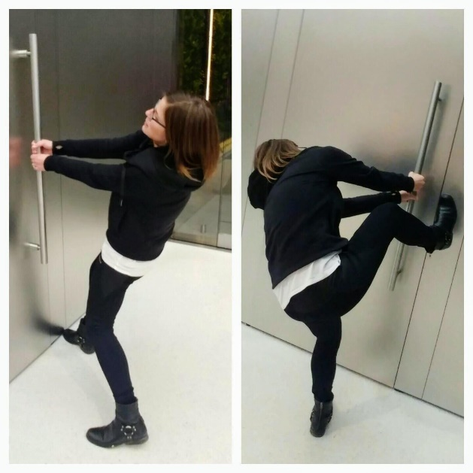
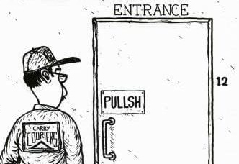
Inhumane (Norman) Doors
Human-Centered Design
https://www.youtube.com/watch?v=yY96hTb8WgI
Notes:
MJ

Slide 19
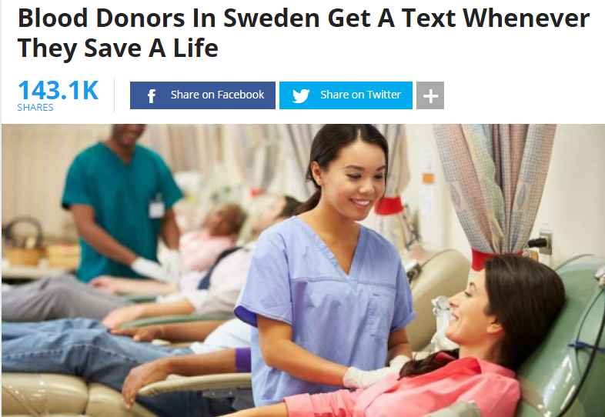
Human-Centered (Swedish) Services
Human-Centered Design
Notes:
MJ

Slide 20
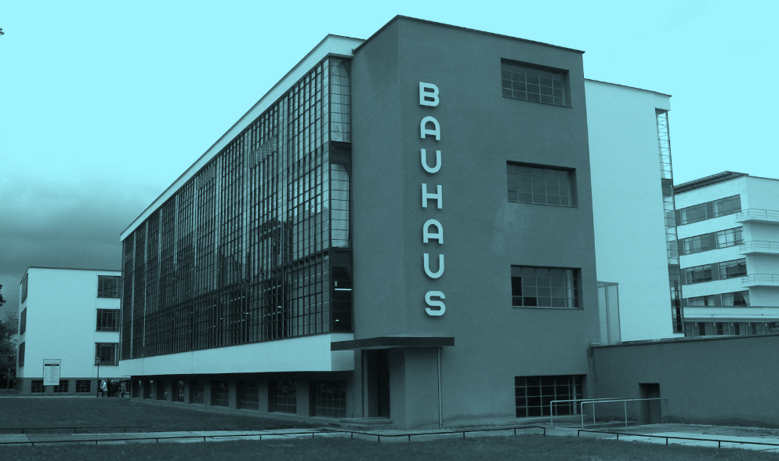
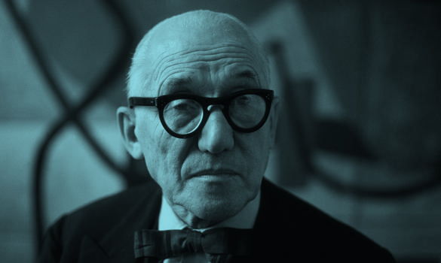
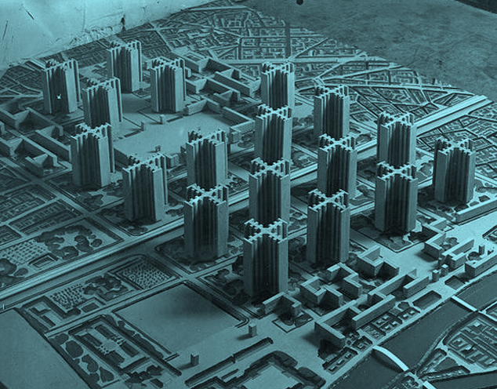
Human-Centered Design
Origins and Evolution of Human-Centered Design
In the ’30s, ’40s, and ’50s…
Modernist architects and industrial designers employed “top-down” approaches to designing, following what they saw as universal rules of form and function.
Notes:
MJ

Slide 21
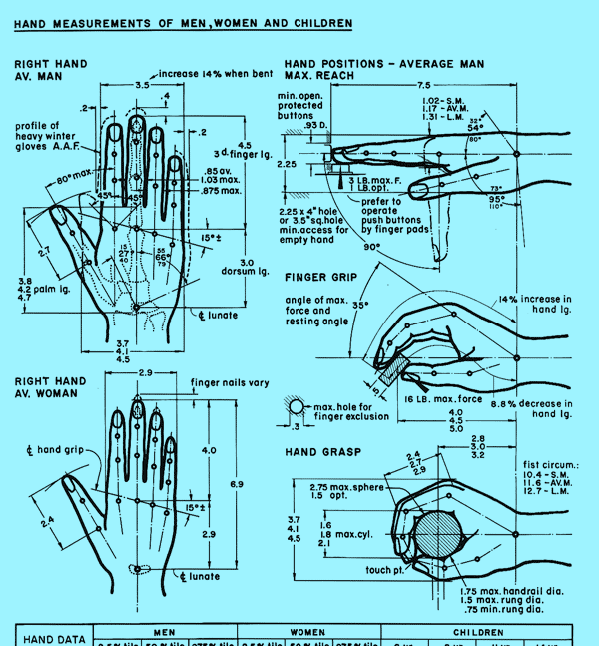
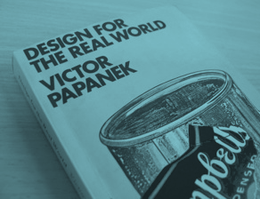
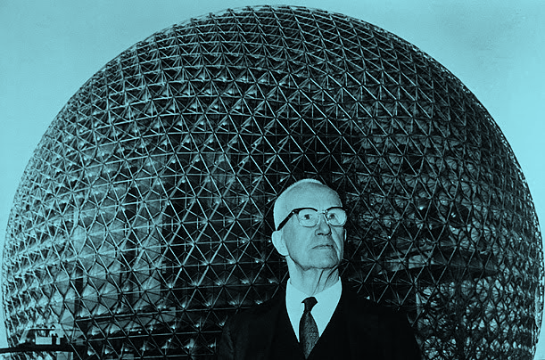
Human-Centered Design
Origins and Evolution of Human-Centered Design
In the ’60s, ’70s, and ’80s…
Computer scientists and management experts formalized processes of designing for particular situations and needs through “diagnosis followed by prescription.”
Notes:
MJ

Slide 22

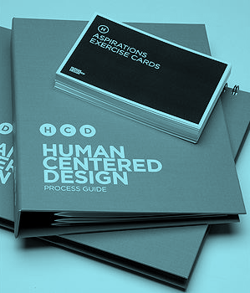
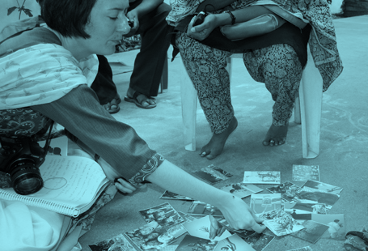
Human-Centered Design
Origins and Evolution of Human-Centered Design
In the ’90s, ’00s, and ’10s…
Restless designers and social innovators have adapted immersive and participatory methods for designing with people, integrating qualitative social-research practices.
Notes:
MJ

Slide 23
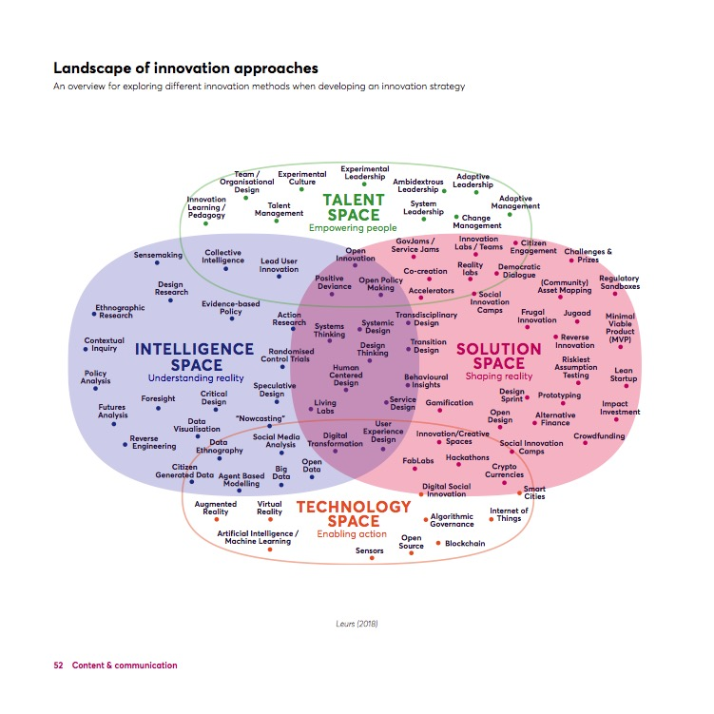
Innovation Landscape
Human-Centered Design
Notes:
MJ

Slide 24
Human-Centered Design
Complementary Practices
HCD is a close cousin to some other innovative practices:
Design Thinking
Design Sprints
Agile Development
Lean Manufacturing
Scenario Planning
Adaptive Leadership
Six Sigma, Etc.
But these are more specific tools and tactics developed by organizations for (or from) particular applications in their work. HCD is a complimentary discipline which can include, but is not wholly defined by, these sorts of methods and mindsets.
Notes:
MJ
HCD is an approach to innovation that can be applied along with many of the popular tactics that have been adopted. It is not in competition with SixSigma or Agile, but compliments these by making sure the outputs are addressing unmet human needs.

Slide 25
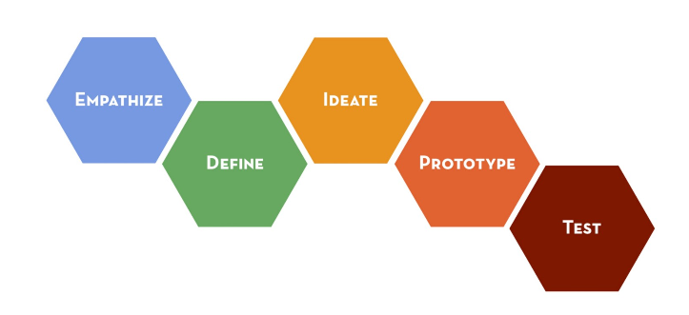
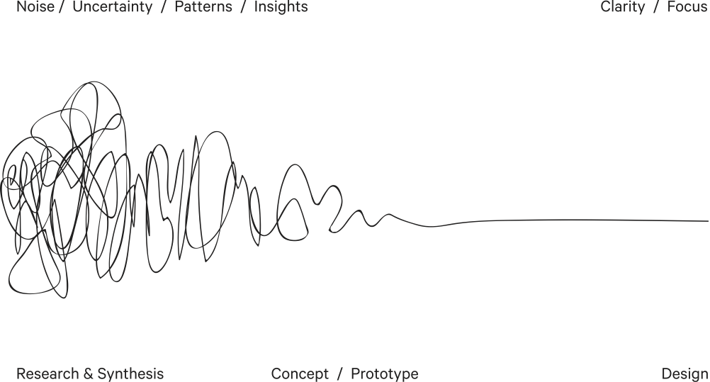
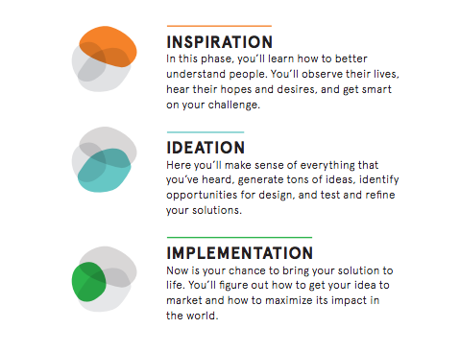
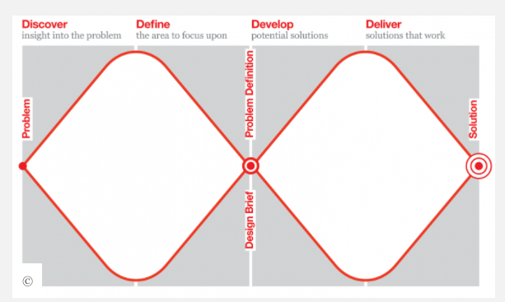
HCD Process Diagrams
Human-Centered Design
Notes:
MJ

Slide 26
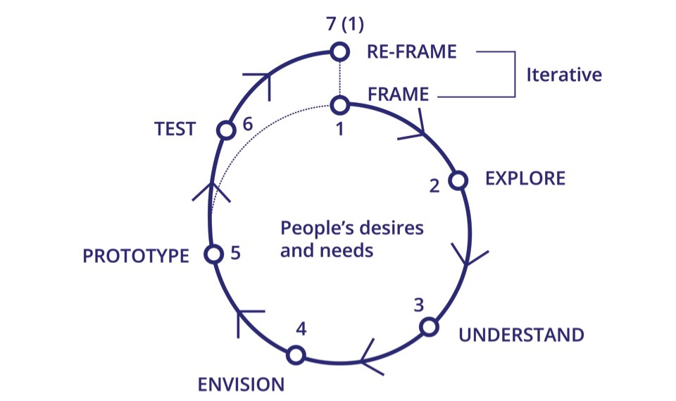
HCD Process Diagrams
Human-Centered Design
Notes:
MJ

Slide 27
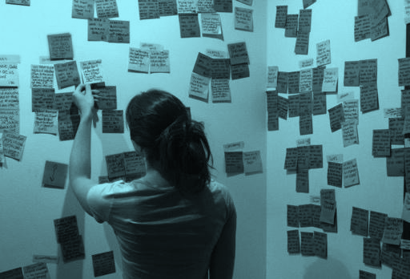
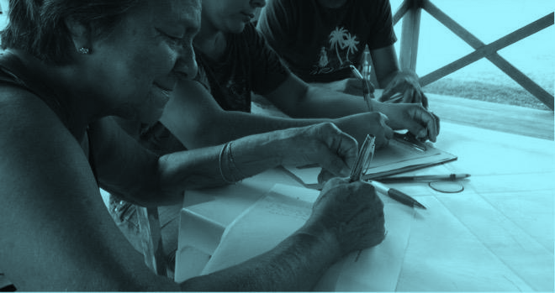
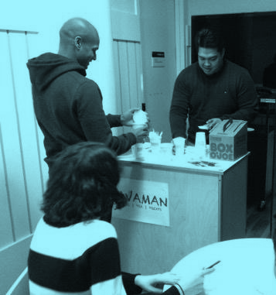
A process greater than the sum of its products
Human-Centered Design
HCD offers a (relatively) new orientation towards design characterized less by its products than its processes. It’s not about predefined material outcomes. It is about solving problems, creating opportunities, and meeting needs.
Notes:
MJ

Slide 28
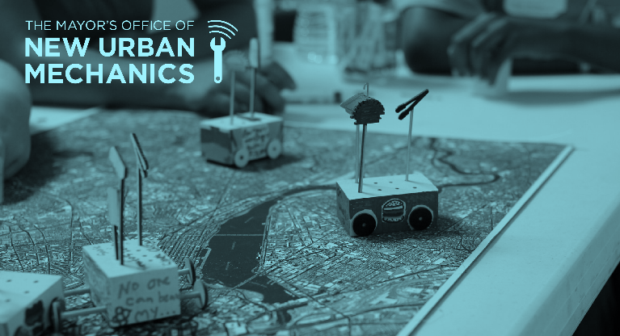
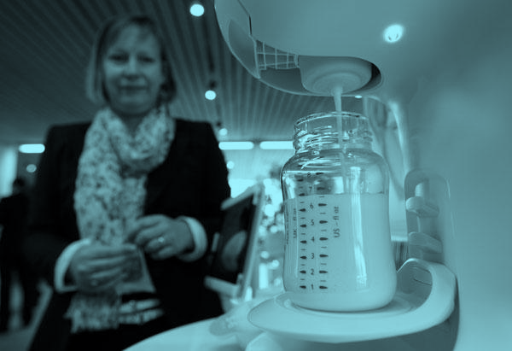
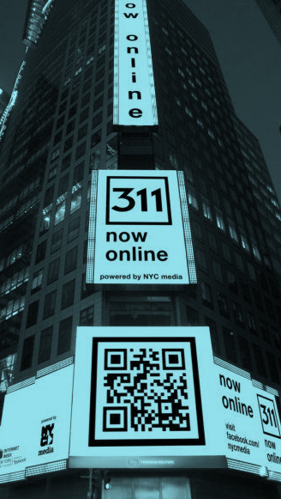
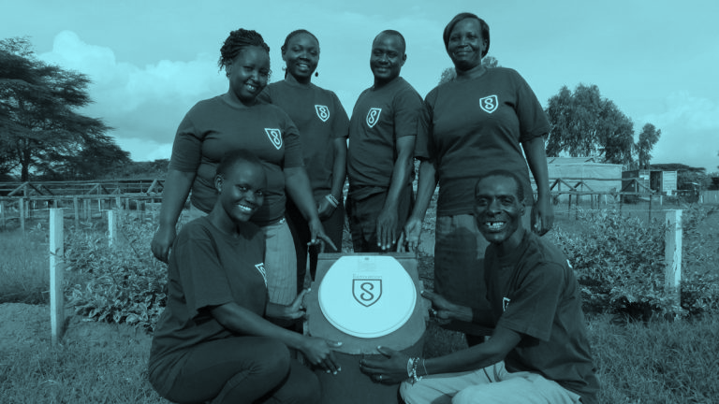
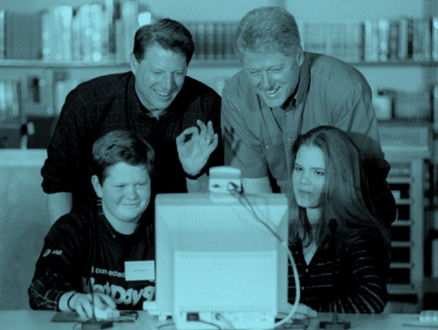

Innovation in government
Human-Centered Design
Although it arose largely from private industry, HCD is uniquely suited to the work of government, where serving people’s needs is both good policy and sound strategy.
Notes:
MJ
“Of the people, by the people, for the people!”

Slide 29
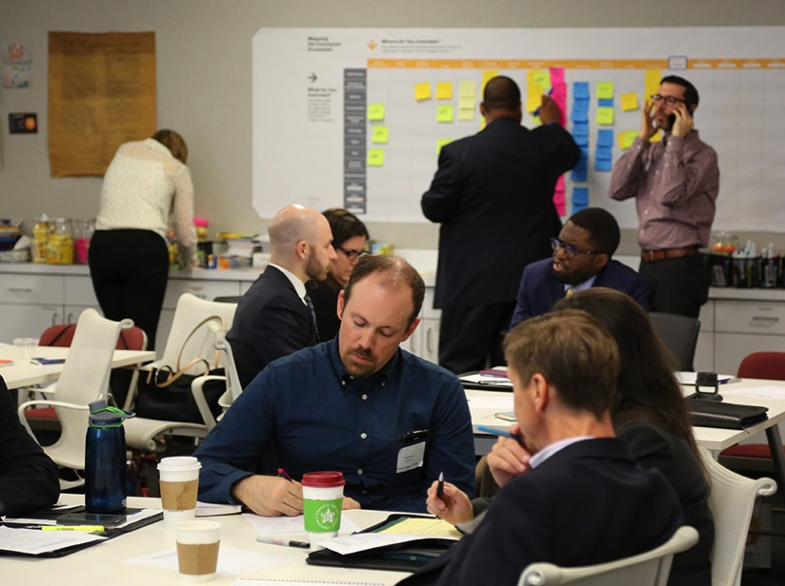
Notes:
MJ

Slide 30
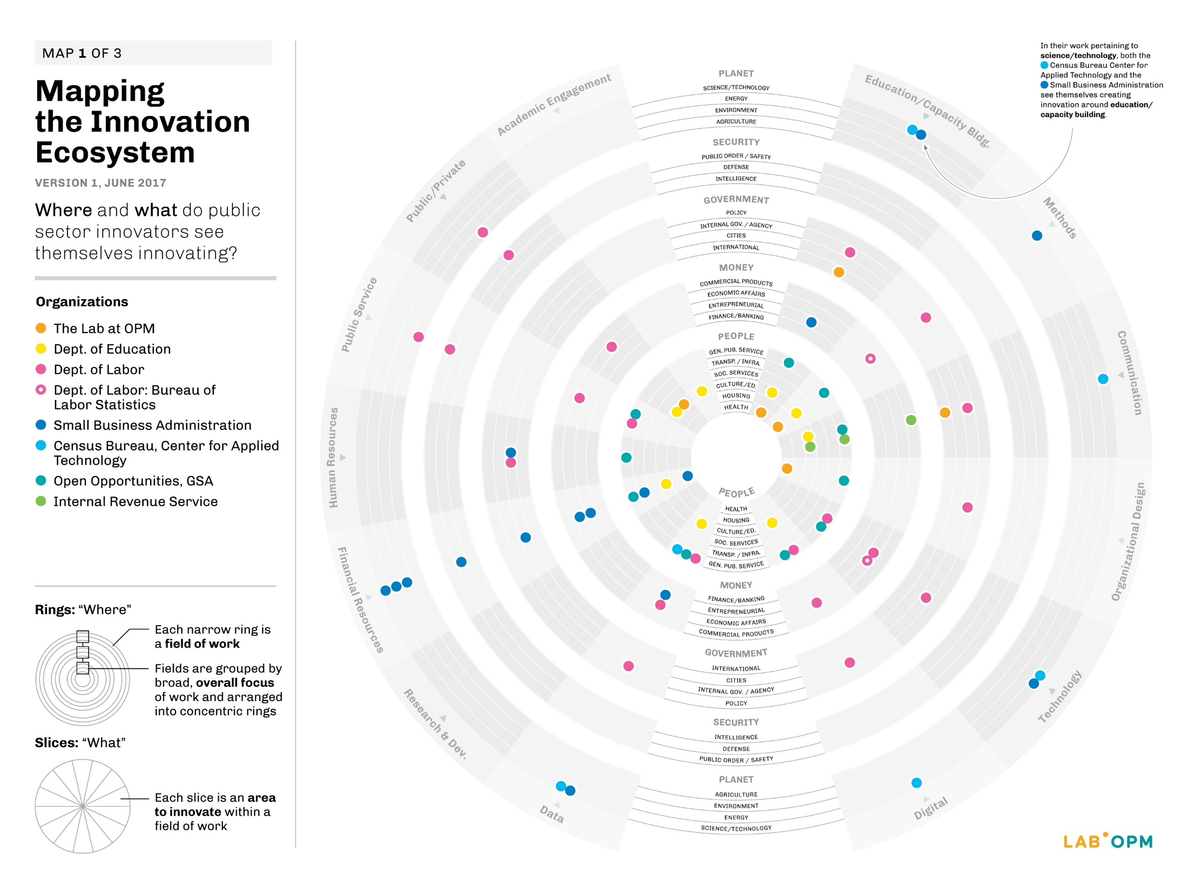
Notes:
MJ

Slide 31
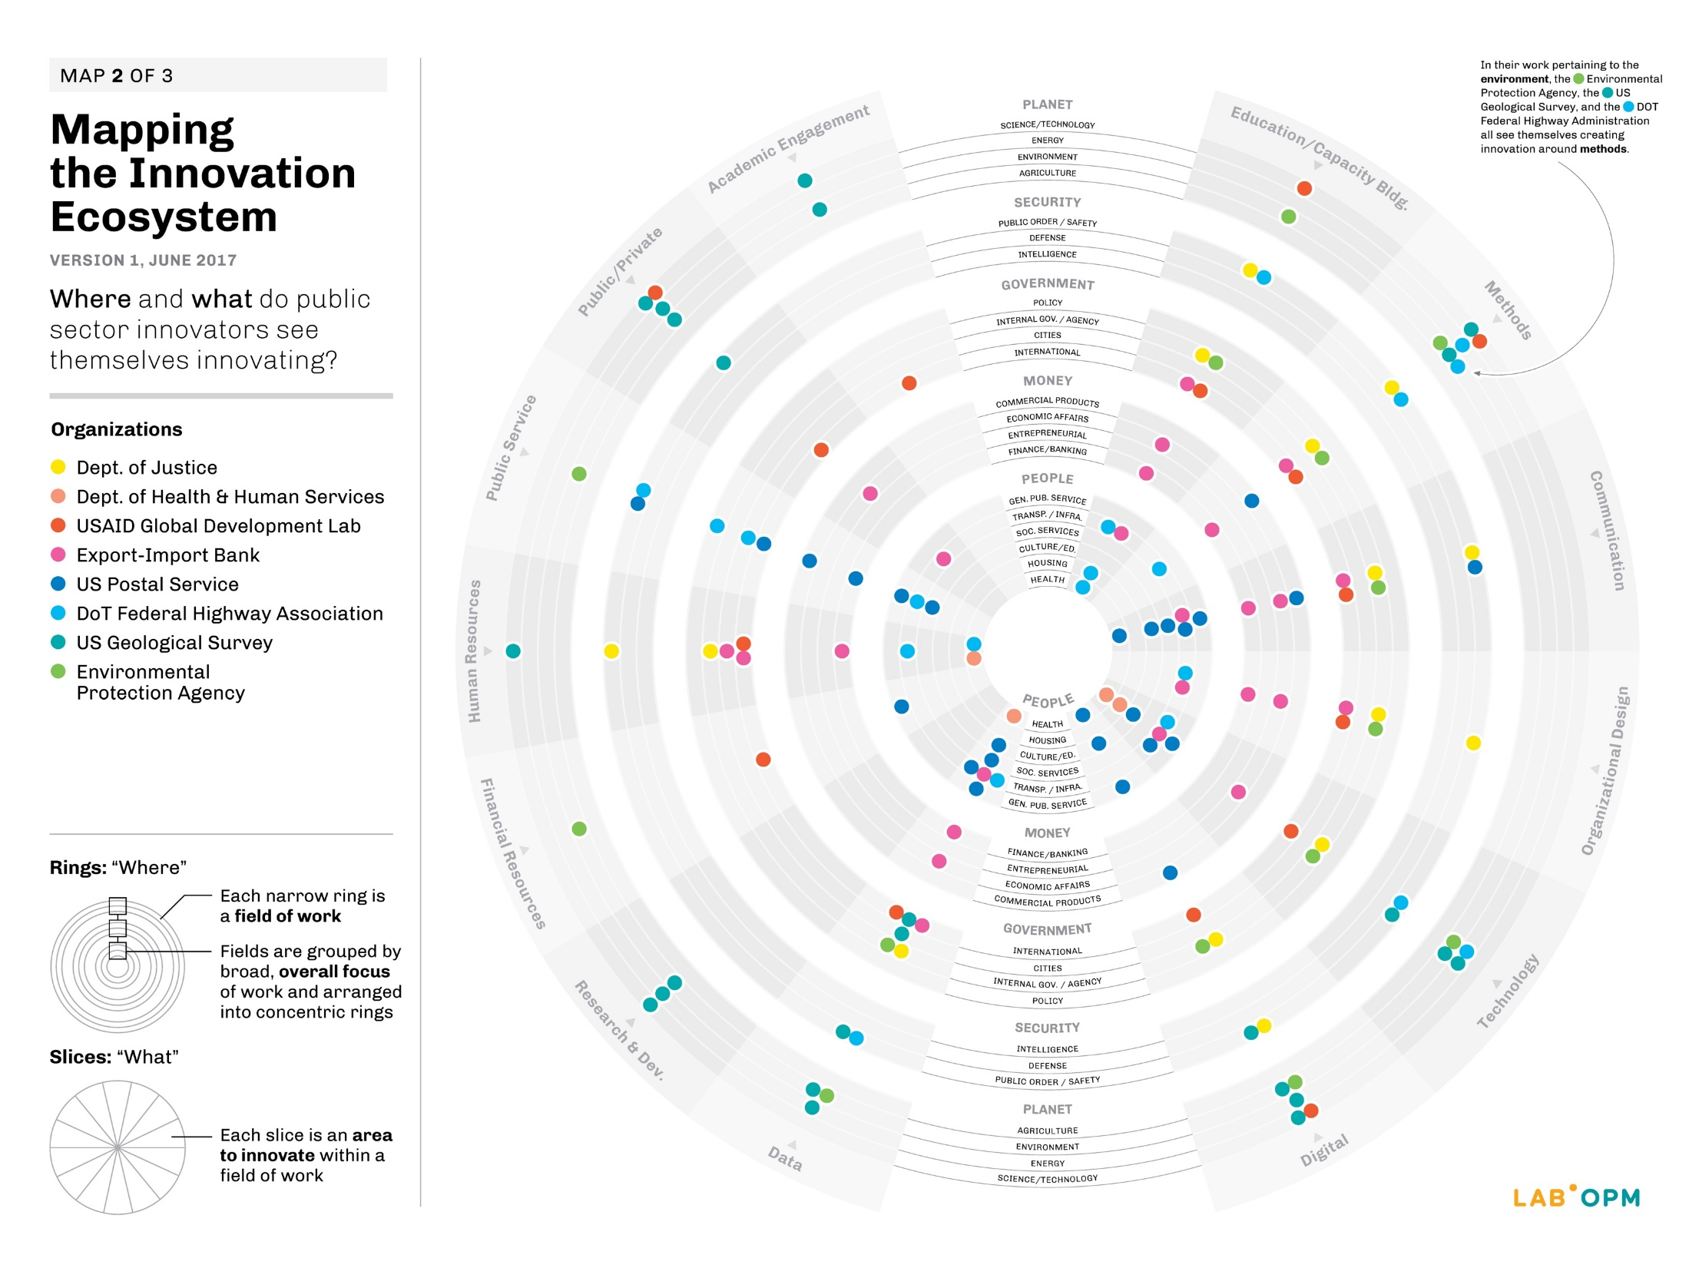
Notes:
MJ

Slide 32
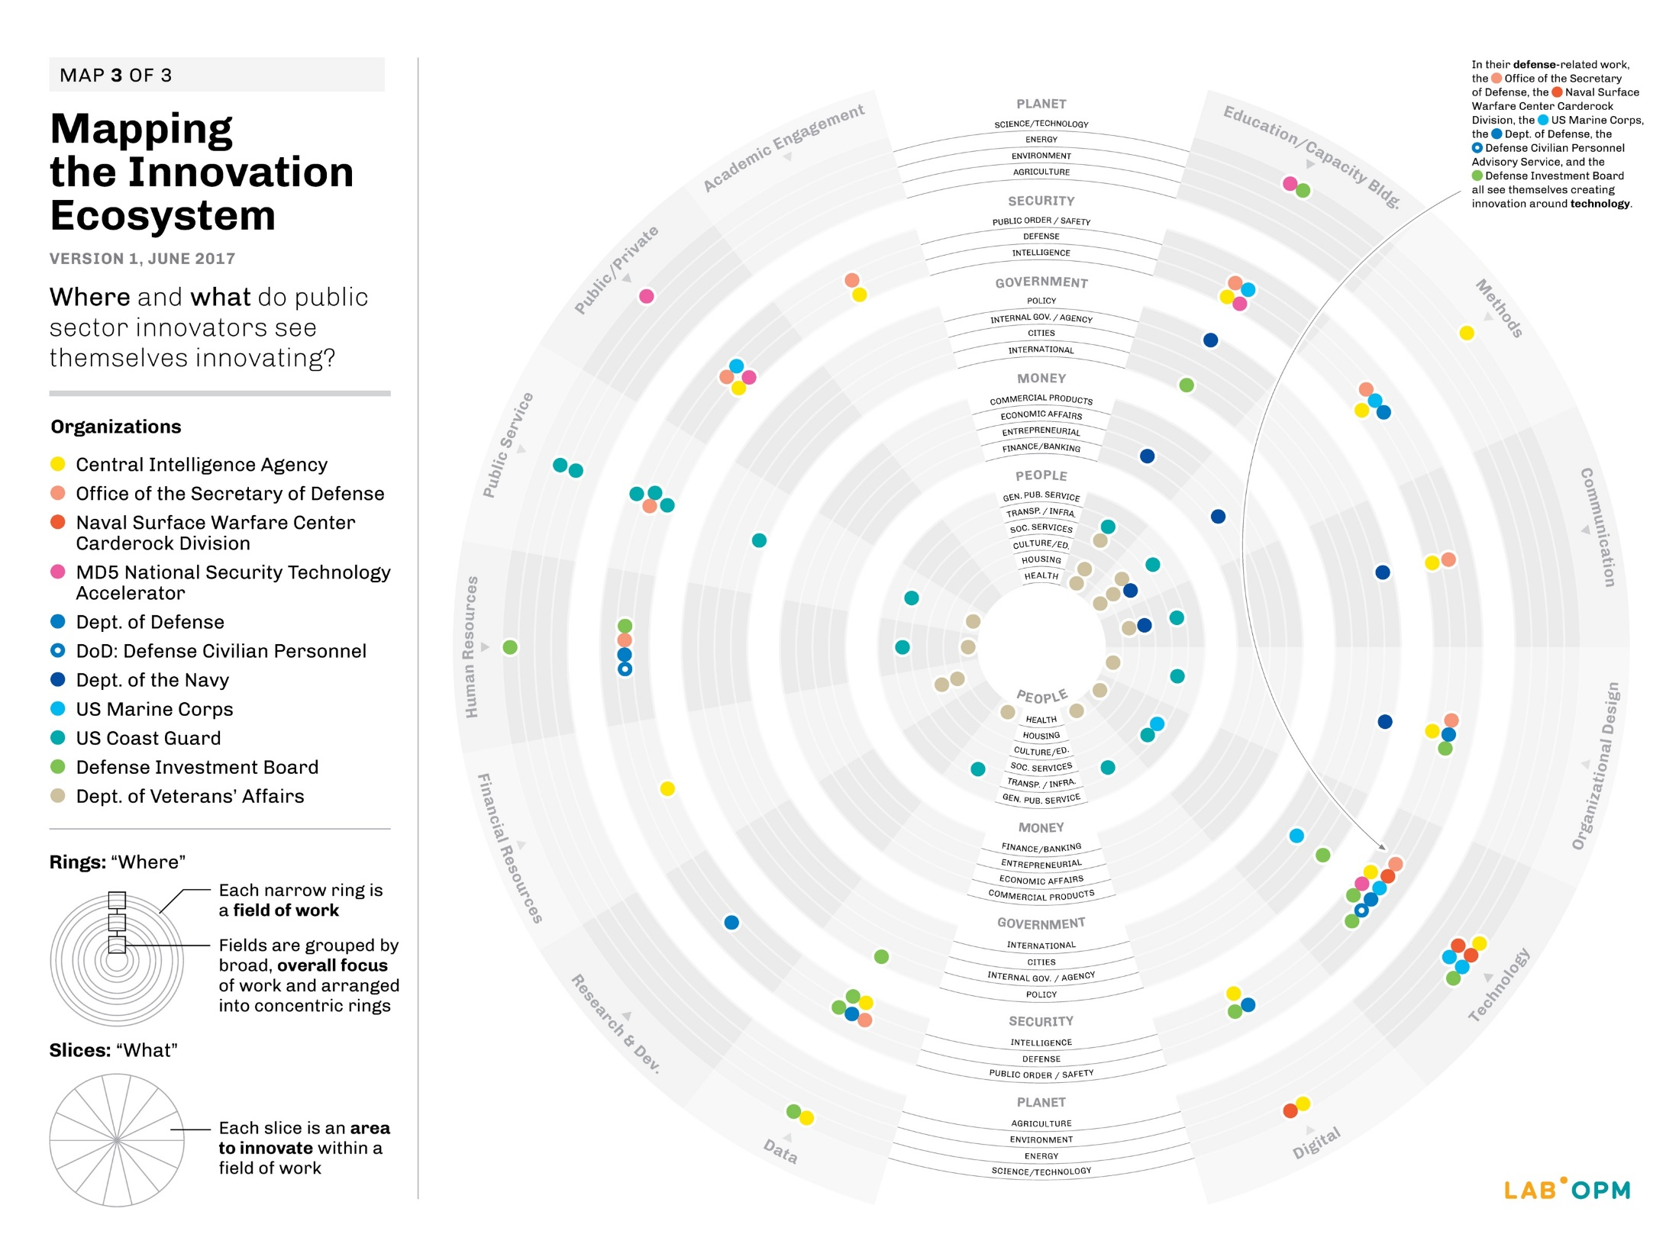
Notes:
MJ

Slide 33
Break
15 min.
Notes:
MJ

Slide 34
FRAME: Problem Framing
Notes:
JC

Slide 35
HCD Process Check-In
Problem Framing
Notes:
JC

Slide 36
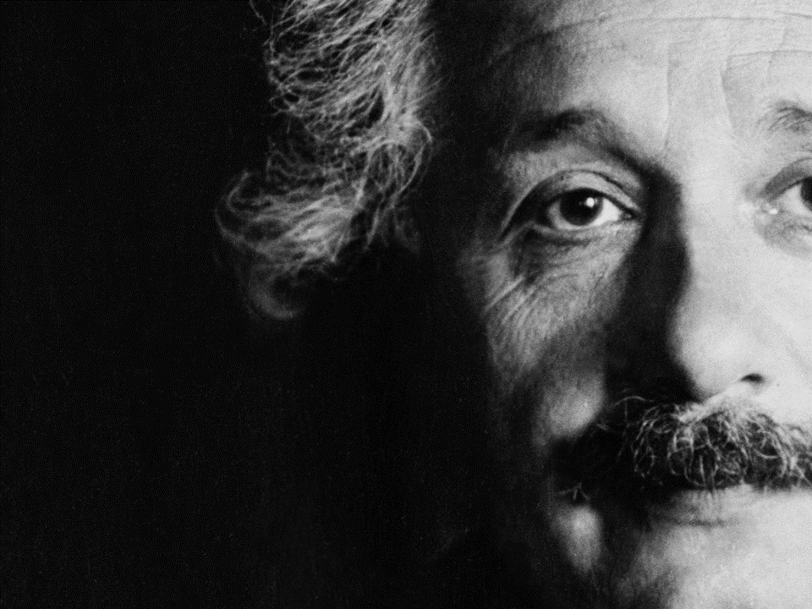
“The mere formulation of a problem is far more often essential than its solution, which may be merely a matter of mathematical or experimental skill. To raise new questions, new possibilities, to regard old problems from a new angle requires creative imagination and marks real advances in science.” [And design!]
“
–
Albert Einstein
Physicist
Problem Framing
Notes:
JC

Slide 37
Let’s give it a try first…
Design a flower vase.
Problem Framing
Notes:
JC

Slide 38
Let’s give it a try first…
Design a flower vase.
Design a way to enjoy
flowers in your home.
Problem Framing
Notes:
JC

Slide 39
Problem Framing
Why do problem framing?
Breakthrough innovation is often the result of simply seeing old problems and opportunities in new ways.
Effective problem framing and reframing allows us to:
Avoid wasting resources on solving the wrong problems
Expand the range of possible solutions to any given problem
Maximize creative leverage and innovative potential of HCD
Notes:
JC

Slide 40

Notes:
JC
Initial problem frame: HMW coordinate standards for face masks between two regulatory agencies (CDC & NIOSH)?

Slide 41

Notes:
JC
We brought in agency stakeholders and field workers for a co-design workshop. Field workers shared that often when its hot or during meal times…

Slide 42

Notes:
JC
They ended up taking off their face masks.
New problem frame: HMW design face mask standards to account for comfort, so that field workers keep their masks on at all times?

Slide 43
Our Design Challenge*
*a task or situation that tests someone’s abilities
Objectives + Expectations
Your challenge for these three days will be:
To improve the experience of “having lunch” for the local workforce of California, MD or Pax River
Notes:
NJ

Slide 44
Domain Mapping
Problem Framing
Notes:
NJ

Slide 45
Domain Mapping: What We’re Focused On
Problem Framing
DOMAINS are factors that will help define the problem. They may be people, places, circumstances, etc. and they may change through the design process.
Notes:
NJ

Slide 46
Domain Mapping: What We Think We Know
Problem Framing
FACTS
ASSUMPTIONS
BIASES
OBJECTIVE
SUBJECTIVE
FACTS are pre-determined data and information points that the team may accept as reliable, for example, previous research, published information, specialized literature, etc.
ASSUMPTIONS include information, facts, or conjectures that have not been sanctioned as reliable but may be important.
BIASES are pre-assumed positions that individuals bring to the table. There are group biases too. In this context, biases are not negative by default, and need to be brought to the table and seen as part of the process.
Notes:
NJ

Slide 47
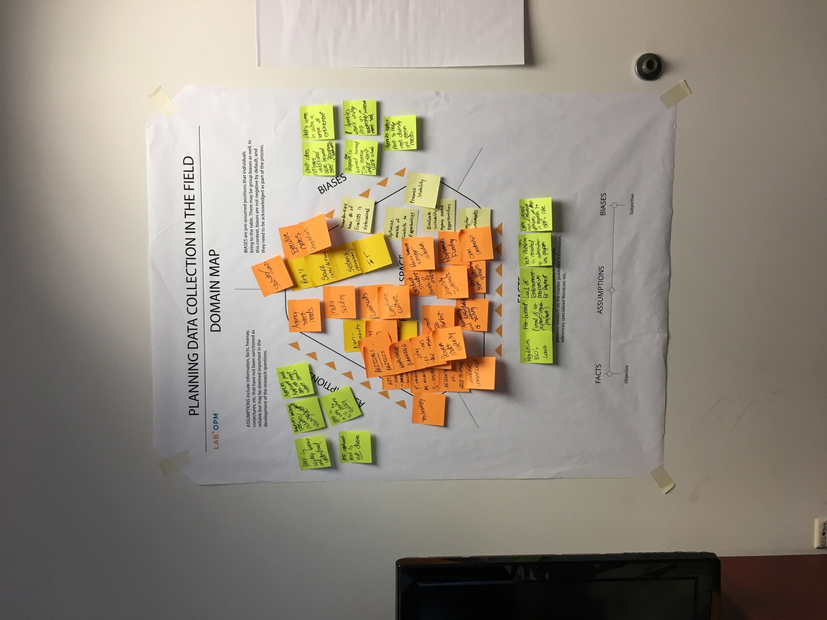
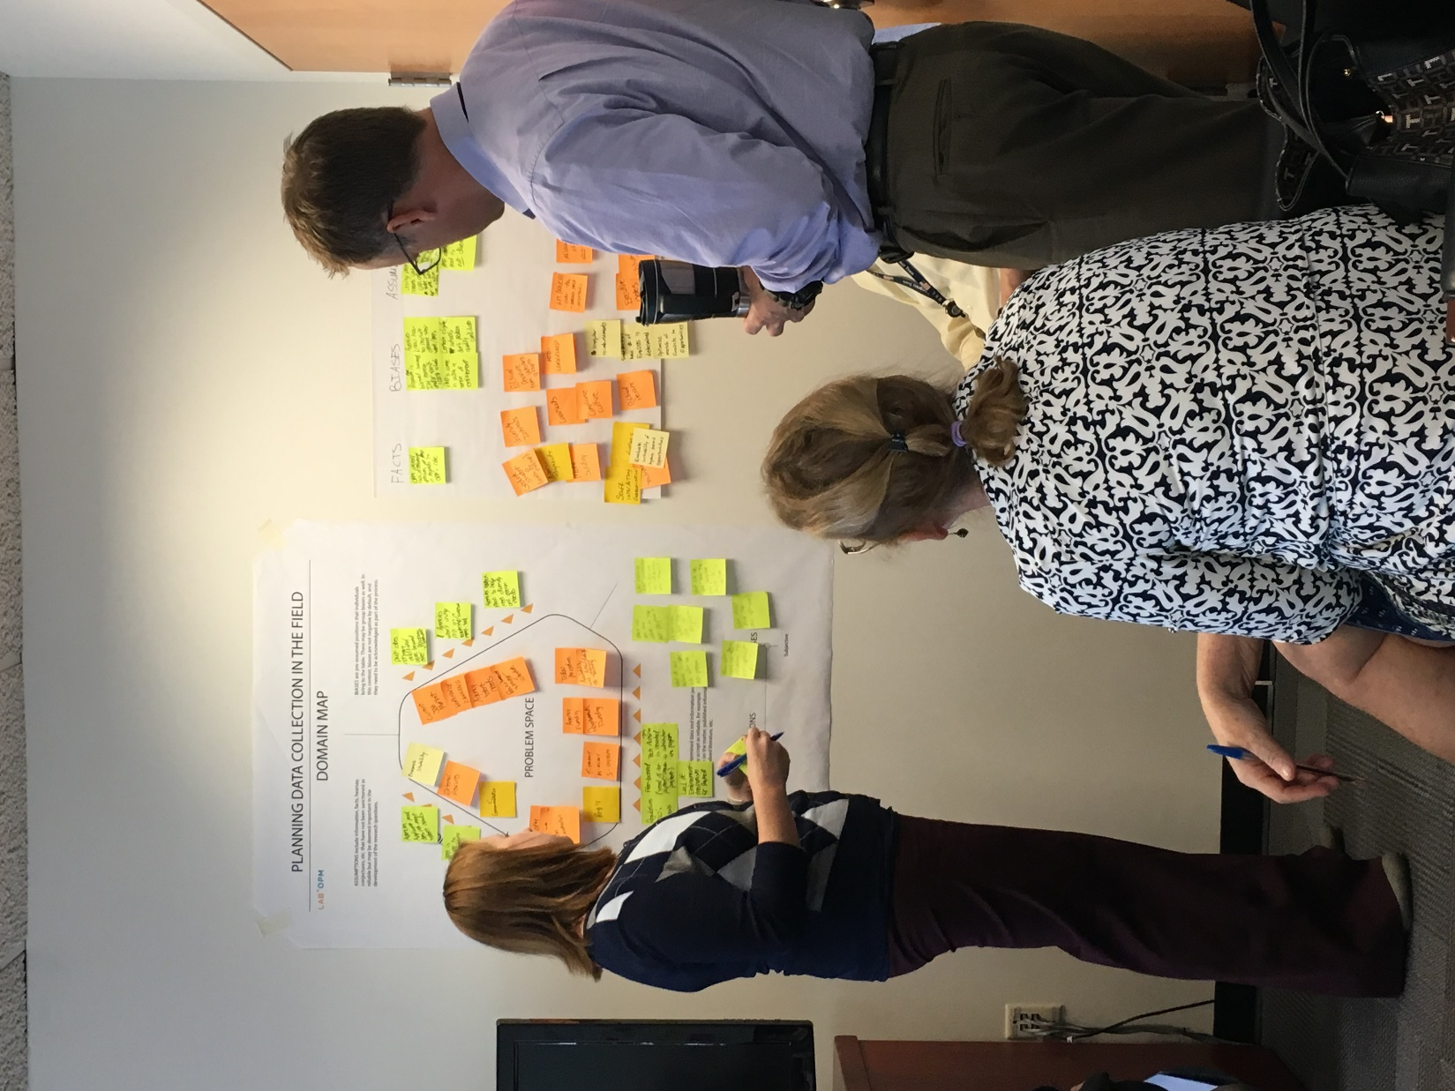
Notes:
NJ

Slide 48
Break
15 min.
Notes:
NJ

Slide 49
EXPLORE:
Design Ethnography
Notes:
JC

Slide 50
HCD Process Check-In
Problem Framing
Notes:
JC

Slide 51
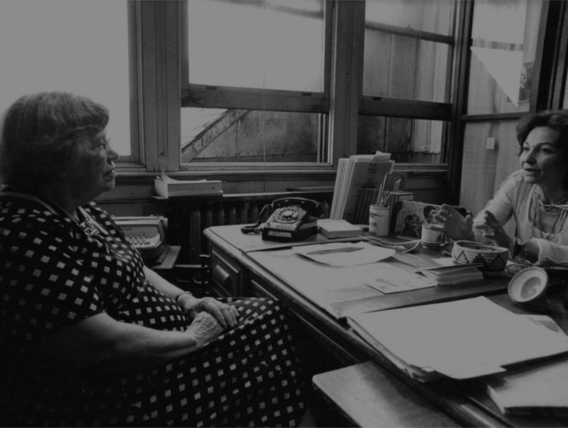
“What people say and what people do and what they say they do are entirely different things.” [Not to mention what we think they do…]
“
–
Design Ethnography
Margaret Mead
Anthropologist
Notes:
JC

Slide 52
Design Ethnography: A Definition
Design ethnography can be described as making the strange familiar and the familiar strange.
Design Ethnography
MAKING THE STRANGE FAMILIAR implies accepting the unknown, the unusual, and the unexpected, as the new normal
MAKING THE FAMILIAR STRANGE means developing a renewed curiosity for what you know, giving it a new value.
Notes:
JC

Slide 53
Design Ethnography: Types of Data
Quantitative data deals with numbers Qualitative data deals with descriptions
Design Ethnography
The age of a painting is QUANTITATIVE DATA.
The pleasure or displeasure it provokes in the viewer is QUALITATIVE DATA.
Notes:
JC

Slide 54
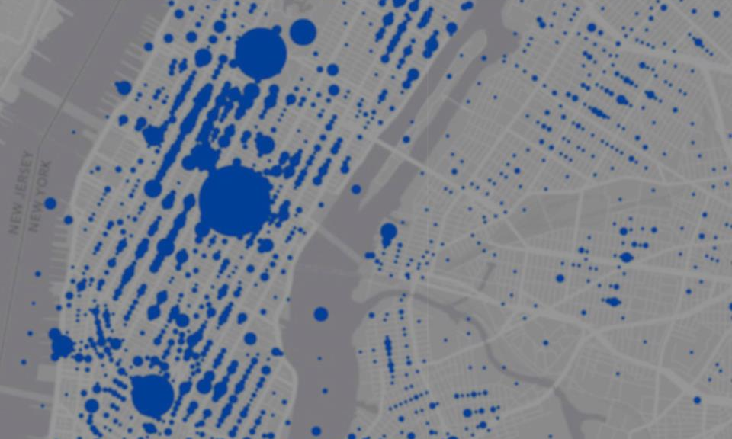
Hurricane Sandy Twitter Map
Design Ethnography
Notes:
JC
Map shows the amount of tweets in areas. The biggest circle is the last Starbucks open in Manhattan, which still had WIFI available. The second biggest circle near Central Park is where a crane had fallen down, creating a lot of property damage. The quantitative data shows that something is happening, but you need the qualitative data to understand what is happening.

Slide 55

Design Ethnography:
Observation
Notes:
JC
Free and reduced school lunch program, Lab in partnership with USDA

Slide 56
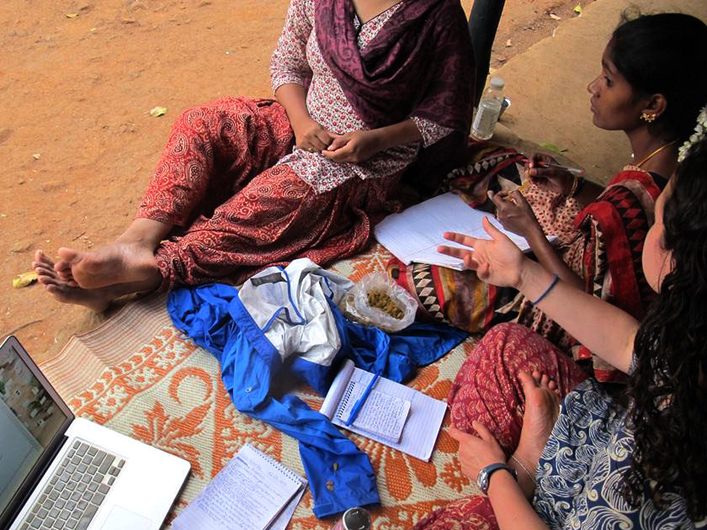
Design Ethnography:
Interviewing
Notes:
JC

Slide 57

Design Ethnography:
Intercepts
Notes:
JC

Slide 58

Design Ethnography:
Shadowing
Notes:
JC

Slide 59

Design Ethnography:
Walk-A-Mile
Notes:
JC
Seaweed farming, Lab in partnership with the Millennium Challenge Corporation

Slide 60
Our Design Challenge*
*a task or situation that tests someone’s abilities
Objectives + Expectations
Your challenge for these three days will be:
To improve the experience of “having lunch” for the local workforce of California, MD or Pax River
Notes:
PG

Slide 61

What to look for: AEIOU Framework
Design Ethnography
Activities Environments Interactions Objects Users A lens for exploring various dimensions of a context, situation, or experience, which could otherwise be overlooked in the field.
Notes:
PG

Slide 62
EXPLORE:
Fieldwork Preparation
Notes:
PG

Slide 63
Observation Tips
Fieldwork Preparation
Observe the big picture. Look at the larger environment and detect relationships between the parts and the whole.
Observe the details. Focus on specific aspects that may provide clues. Be Sherlock Holmes.
Consider hidden connections. Look for hidden forces shaping the situation at hand.
Observe with all your senses: sight, smell, sound and touch.
Notes:
PG

Slide 64
Interviewing Tips
Fieldwork Preparation
Interview in pairs when possible.
Use facial expressions, body language, and non-verbal cues—not sounds—to show you’re listening and understanding.
Ask interviewees to “Tell me more,” and echo back what they’re saying.
Don’t be afraid of a little silence. Welcome it. Don’t rush the person you’re interviewing
Don’t try to rescue or provide answers. (e.g. “Did you mean this?”)
Ask questions you think know the answer to.
Ask ”Why?”
Follow the conversation where it leads, but steer things back on track when you need to.
Notes:
PG

Slide 65
Closed vs. Open Questions
Fieldwork Preparation
Close-ended questions are good for:
gathering quantitative data for group profile
helping understand the context in which people tell stories
helping warm up the interviewee or giving them a breather (because they’re easier to answer)
Open-ended questions are good for:
uncovering people’s point of view
revealing how people make sense of and explain their experience
uncovering key metaphors, ethical codes, and images that resonate most with people or groups
Notes:
PG

Slide 66







Research Tools
Fieldwork Preparation
Notes:
PG

Slide 67





Data Collection
Fieldwork Preparation
“
“
“
“
Notes:
PG

Slide 68
Discussion Guides
Fieldwork Preparation
Introduction and Background: Introduce yourself, explain what you’re doing, and why you’re doing it.
Warm-Up Questions
Start with questions that make the person feel at ease and introduce the context for your conversation.
Cross-Cutting Questions
Try questions that you will be able to ask universally but will still draw responses focused on the topic.
Follow-Up Questions
Listen and respond with questions that provide room for the person to tell a story.
Wrap-up Questions
End with questions and statements that naturally wrap things up. Say thanks!
Notes:
PG

Slide 69
Our Design Challenge*
*a task or situation that tests someone’s abilities
Objectives + Expectations
Your challenge for these three days will be:
To improve the experience of “having lunch” for the local workforce of California, MD or Pax River
Notes:
PG

Slide 70
Sample Questions
Fieldwork Preparation
Topical Questions
Can you tell me how you spend your lunchtime?
How long have you been doing that?
What kind of interactions do you have?
Ever have problems during lunchtime?
What might improve your lunchtime expereince?
Open Questions
What does that mean to you?
How do you make sense of that?
How does that make you feel?
How would you describe _____?
Can you say more about that?
Notes:
PG

Slide 71
Fieldwork Mission
Fieldwork Preparation
1. Create Discussion Guide Write down (4-5) questions you to ask the people you speak with in the field, and consider questions for different groups—base staff, local residents, restaurant employees, etc..
2. Decide Researcher Roles Decide who will be your interviewer, note taker(s), photographer(s), and observer(s) for each interview. You can rotate roles and divide up to cover more ground.
3. Conduct Your Fieldwork Speak to as many people as you can at cafes, food trucks, delis, etc.. Take plenty of notes and pictures (if allowed). You will need this data for the work ahead.
Email photos for printing: peter.gorman@opm.gov
Notes:
PG

Slide 72
Lunch + Fieldwork
Notes:
PG

Slide 73
Reflect:
Fieldwork Debrief
Notes:
MJ

Slide 74
Fieldwork Debrief
Fieldwork Debrief
How’d it go?
Any funny moments to share?
Any key insights or revelations?
Any surprises or challenges?
Anything you’d do differently?
What’s next?
Capture any last observations.
Tidy up and compile your notes.
Email us any pictures to print.
Have your data handy tomorrow.
Rest up, and we’ll
see you tomorrow!
Notes:
MJ

Slide 75
Thank You
Notes:
MJ

